Slide 1


Engs 28
Embedded Systems
Day 6

Slide 2
A few updates from HiTA
They experienced issues with one of their providers yesterday and the day before - should be all set now.
"There are cases where the structure of the table will not be completely understood by the assistant or, if the table is an image, the numbers can be "seen" inaccurately. Unfortunately there's not too much small tweaking that we can do that we haven't already explored in the past."
If HiTA has provided you with code that include something like #include <avr/io.h> #include <delay.h> please show me the conversation so that I can determine where it appears to be finding this code.

Slide 3
Code review / demo: Keyboard-Controlled Counter
Create a counter that starts at 0 and counts up by one every time 'u' or 'U' is pressed on the keyboard and down by one every time 'd' or 'D' is pressed. Other key presses should be ignored.
Counter should include negative values if you decrement below 0. Use the int8_t datatype for your counter: this is an integer that is only 8 bit wide.
Begin with the template on the next slide.
Testing:
Simple increment and decrement
Decrement below 0 to confirm negative numbers
Increment all the way to the maximum value, and beyond. What do you observe?
With your group, demo your design, read and discuss each other’s code.

Slide 4
Sample solution...
Use CoolTerm as a serial monitor.
#include <stdio.h>
#include "ES28.h"
#include "uart.h"
int main(void) {
int key;
int8_t counter = 0;
// Initialize the UART
uart2_init();
// A little message to show that the program has started
printf("Keyboard-controlled up-down counter\r\n");
while(1) {
key = uart2_read();
if ((key == 'u') || (key == 'U')) {
// increment and print
printf("%d\r\n", ++counter);
} else if ((key == 'd') || (key == 'D')) {
// decrement and print
printf("%d\r\n", --counter);
}
}
return 0;
}

Slide 5
Setting and Clearing Pins, Revisited

Slide 6
Example: Enable clock for GPIOA and GPIOB
#include "ES28.h"
(...)
int main(void) {
RCC->IOPENR |= (1U<<0 | 1U<<1); // Enable clock access to GPIOA and B
(...)
}
Open the STM32C0x1 Reference Manual and use it to fill in this table:
 | Name | How to refer to it in code
Register in which to enable GPIO ports
Bit to enable GPIOA
Bit to enable GPIOB
Code to enable GPIOA:
Code to enable GPIOB:
Code to enable both at the same time:

Slide 7


Slide 8
Example: Enable clock for GPIOA and GPIOB
#include "ES28.h"
(...)
int main(void) {
RCC->IOPENR |= (1U<<0 | 1U<<1); // Enable clock access to GPIOA and B
(...)
}
Open the STM32C0x1 Reference Manual use it to fill in this table:
 | Name | How to refer to it in code
Register in which to enable GPIO ports | RCC_IOPENR | RCC->IOPENR
Bit to enable GPIOA | GPIOAEN | RCC_IOPENR_GPIOAEN
Bit to enable GPIOB | GPIOBEN | RCC_IOPENR_GPIOBEN
Code to enable GPIOA: RCC->IOPENR |= RCC_IOPENR_GPIOAEN;
Code to enable GPIOB: RCC->IOPENR |= RCC_IOPENR_GPIOBEN;
Code to enable both at the same time:
RCC->IOPENR |= (RCC_IOPENR_GPIOAEN | RCC_IOPENR_GPIOBEN);

Slide 9
Example: Set mode register for PA5 to output mode
#include "ES28.h"
(...)
int main(void) {
(...)
GPIOA->MODER |= (1U<<10); // 2. Configure PA5 (Port A, bit 5)
GPIOA->MODER &= ~(1U<<11);
(...)
}
Open the STM32C0x1 Reference Manual and use it to fill in this table:
 | Name | How to refer to it in code
Register in which to set mode for PA5
Bits to modify for PA5
Code to configure PA5 as output pin:
Is there a better way? Idea: clear both bits, then write both bits at the same time with their respective values. How?

Slide 10
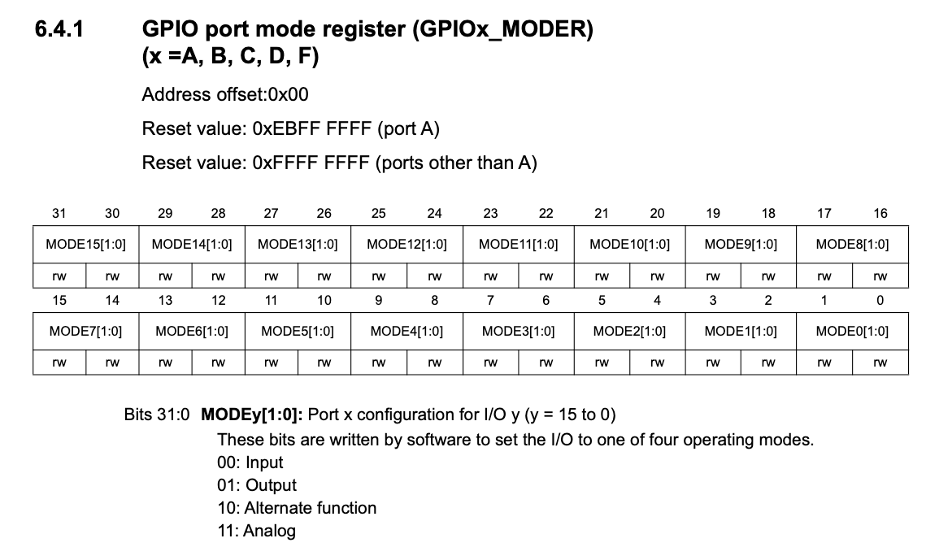
Example: Set mode register

Slide 11
Example: Set mode register for PA5 to output mode
#include "ES28.h"
(...)
int main(void) {
(...)
GPIOA->MODER |= (1U<<10); // 2. Configure PA5 (Port A, bit 5)
GPIOA->MODER &= ~(1U<<11);
(...)
}
Open the STM32C0x1 Reference Manual and use it to fill in this table:
 | Name | How to refer to it in code
Register in which to set mode for PA5 | GPIOA_MODER | GPIOA->MODER
Bits to modify for PA5 | MODE5[0] MODE5[1] | GPIO_MODER_MODE5_0 GPIO_MODER_MODE5_1
Code to configure PA5 as output pin:
GPIOA->MODER |= GPIO_MODER_MODE5_0;
GPIOA->MODER &= ~GPIO_MODER_MODE5_1;
Is there a better way? Idea: clear both bits, then write both bits at the same time with their respective values. How?

Slide 12
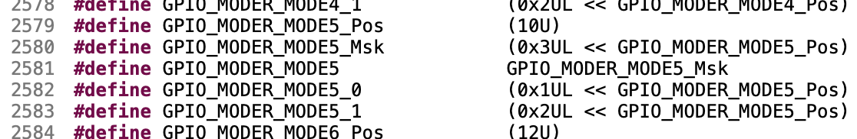
Another Way
In stm32c031xx.h:
Goal: Make this code more readable:
GPIOA->MODER |= GPIO_MODER_MODE5_0;
GPIOA->MODER &= ~GPIO_MODER_MODE5_1;
Step 1: Clear all bits involved in setting the mode for PA5:
Step 2: Shift the correct value into both bits at once:
GPIOA->MODER |= (?? << GPIO_MODER_MODE5_Pos);
What should you put for "??"
Mode | Values of the two bits | Value for "??"
Input
Output
Alternate Function
Analog

Slide 13
Another Way
In stm32c031xx.h:
Goal: Make this code more readable:
GPIOA->MODER |= GPIO_MODER_MODE5_0;
GPIOA->MODER &= ~GPIO_MODER_MODE5_1;
Step 1: Clear all bits involved in setting the mode for PA5:
GPIOA->MODER &= ~GPIO_MODER_MODE5_Msk;
Step 2: Shift the correct value into both bits at once:
GPIOA->MODER |= (?? << GPIO_MODER_MODE5_Pos);
What should you put for "??"
Mode | Values of the two bits | Value for "??" | Macro name
Input | 00 | 0 | GPIO_INPUT
Output | 01 | 1 | GPIO_OUTPUT
Alternate Function | 10 | 2 | GPIO_ALTERNATE
Analog | 11 | 3 | GPIO_ANALOG

Slide 14
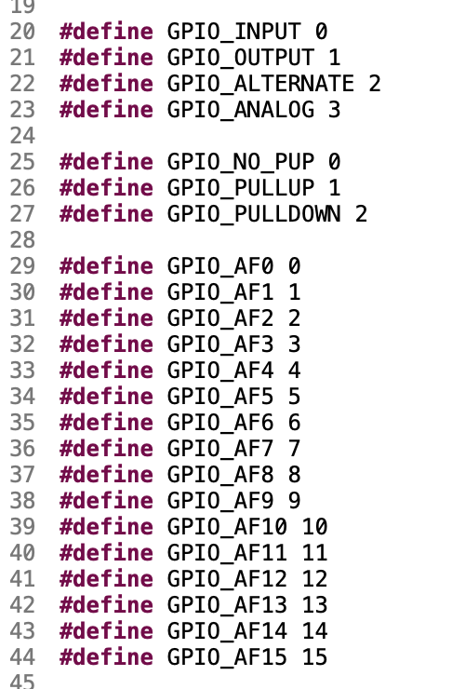
Upshot
In ES28.h:
To set PA5 to…:
Input mode | GPIOA->MODER &= ~GPIO_MODER_MODE5_Msk; GPIOA->MODER |= (GPIO_INPUT << GPIO_MODER_MODE5_Pos);
Output mode | GPIOA->MODER &= ~GPIO_MODER_MODE5_Msk; GPIOA->MODER |= (GPIO_OUTPUT << GPIO_MODER_MODE5_Pos);
Alternate function mode | GPIOA->MODER &= ~GPIO_MODER_MODE5_Msk; GPIOA->MODER |= (GPIO_ALTERNATE << GPIO_MODER_MODE5_Pos);
Analog mode | GPIOA->MODER &= ~GPIO_MODER_MODE5_Msk; GPIOA->MODER |= (GPIO_ANALOG << GPIO_MODER_MODE5_Pos);

Slide 15
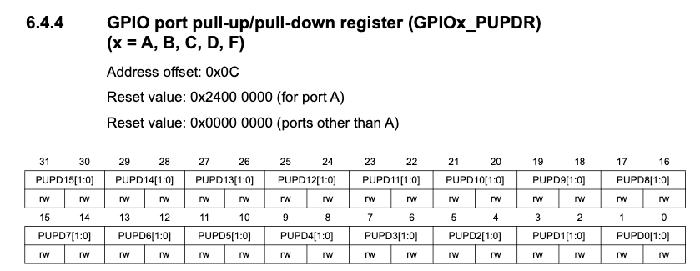
Your Turn!
In ES28.h:
Enable the pullup for PB4. Code we used previously:
GPIOB->PUPDR |= (1U<<8);
GPIOB->PUPDR &= ~(1U<<9);
Replace this with our new macro language.

Slide 16
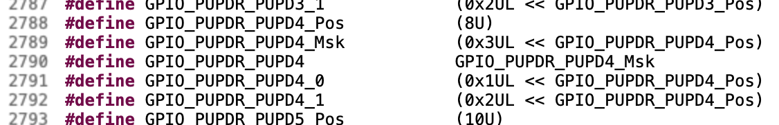
Your Turn!
In ES28.h:
Enable the pullup for PB4. Code we used previously:
GPIOB->PUPDR |= (1U<<8);
GPIOB->PUPDR &= ~(1U<<9);
Replace this with our new macro language.
GPIOB->PUPDR &= ~GPIO_PUPDR_PUPD4_Msk;
GPIOB->PUPDR |= (GPIO_PULLUP << GPIO_PUPDR_PUPD4_Pos);
In stm32c031xx.h:

Slide 17
Transistors

Slide 18
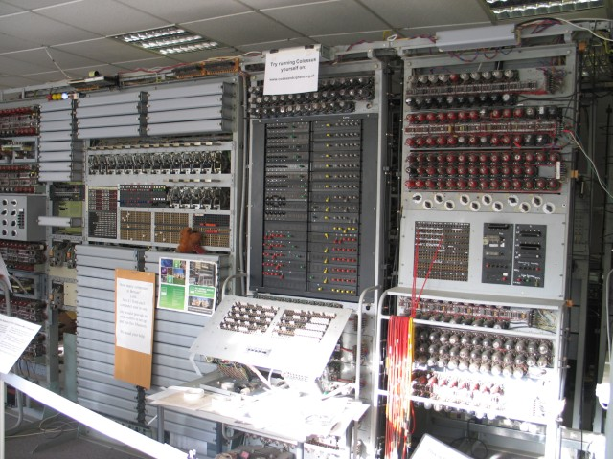
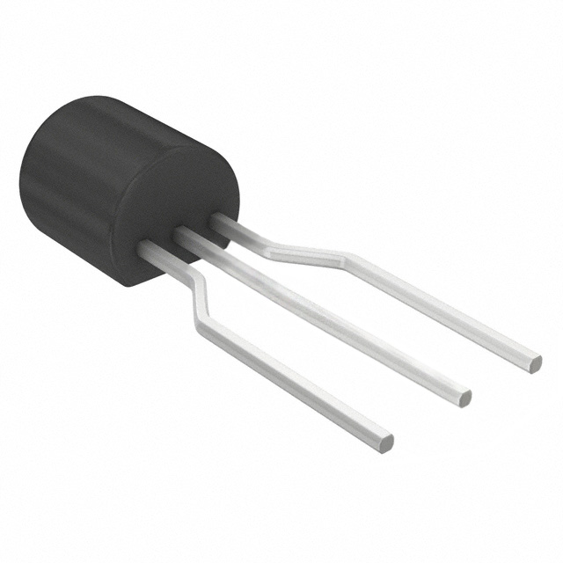
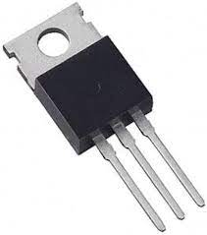
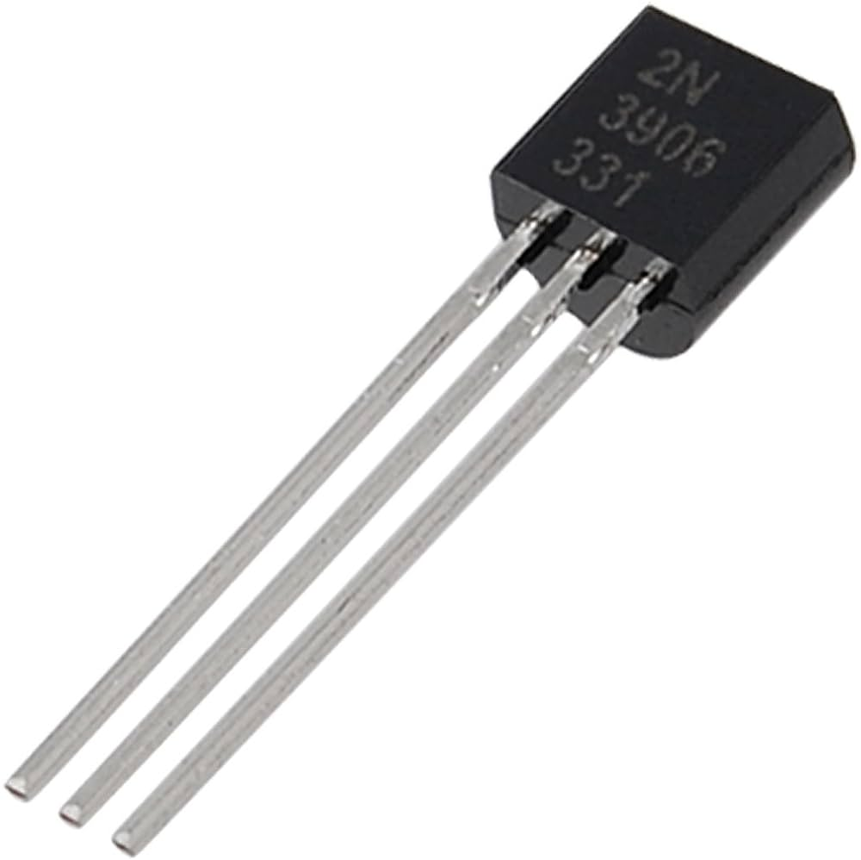
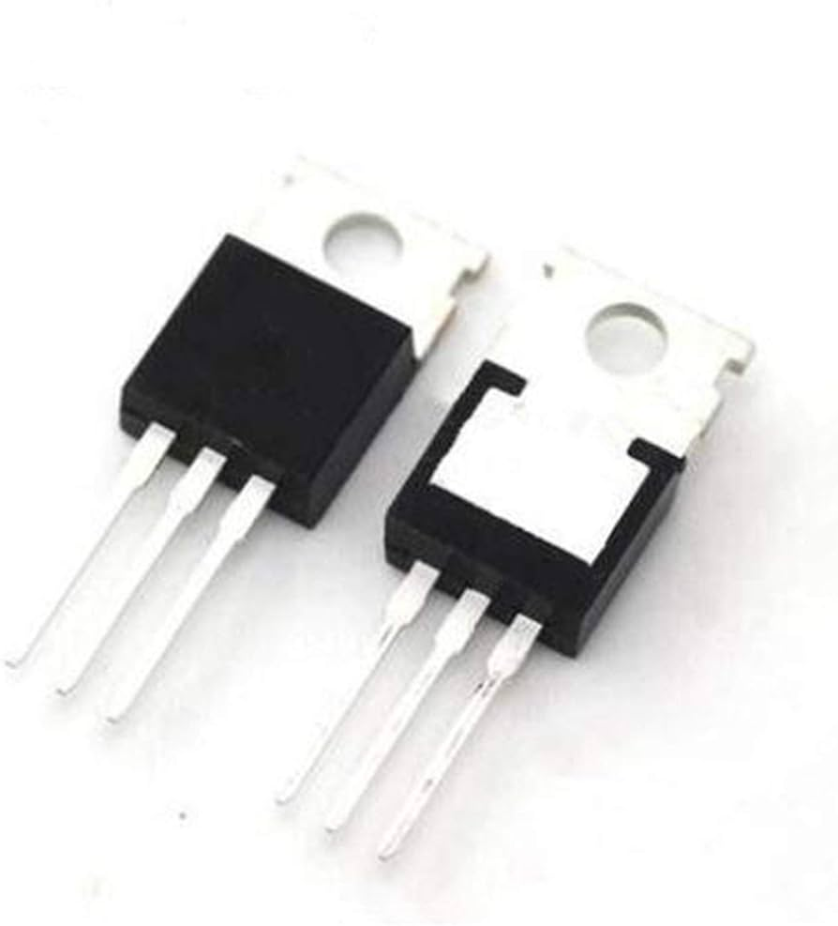
Introduction to Transistors
Transistors form the basic building blocks of all computer hardware.
Invented by William Shockley, John Bardeen and Walter Brattain in 1947, replacing previous vacuum tube technology.
Won Nobel Prize for Physics in 1956.
Used for applications such as amplification, switching and digital logic design.
COLOSSI computer using 2,400 vacuum tubes for logic circuitry.
Notes:
Shockley took top billing, but Bardeen and Brattain actually built the device.
How a vacuum tube works?
1. Electron Emission: The filament heats the cathode, causing it to release electrons into the vacuum via thermionic emission.
2. Electron Flow: A voltage applied between the cathode (negative) and the anode (positive) creates an electric field, causing the electrons to accelerate toward the anode.
3. Signal Modulation: The control grid, placed near the cathode, influences the flow of electrons:
• A small negative voltage on the control grid repels some electrons, reducing the current reaching the anode.
• A less negative (or positive) grid allows more electrons to pass through, increasing the current.
4. Amplification: A small input signal applied to the control grid modulates a much larger current flow to the anode, amplifying the signal.

Slide 19
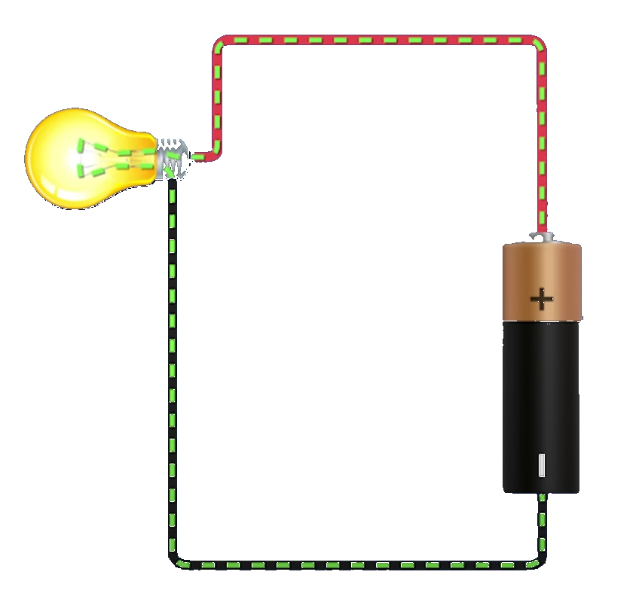
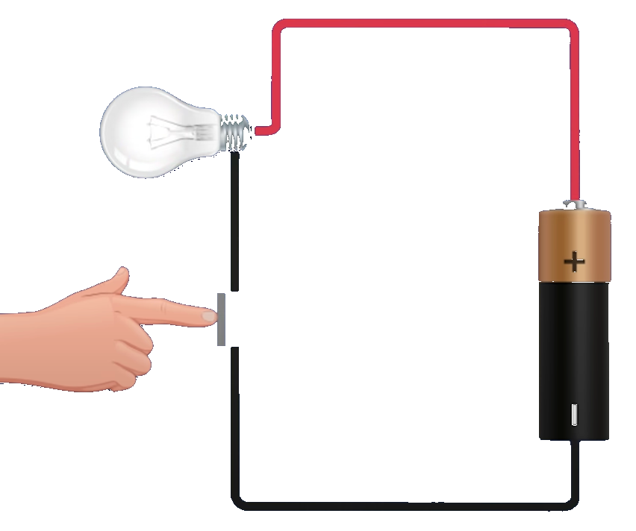
What can a transistor do?
A circuit can be turned on and off with a switch.

Slide 20
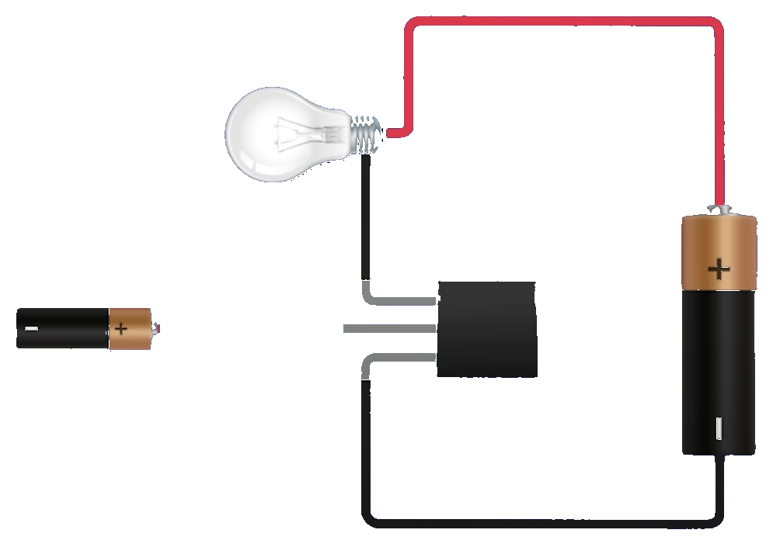
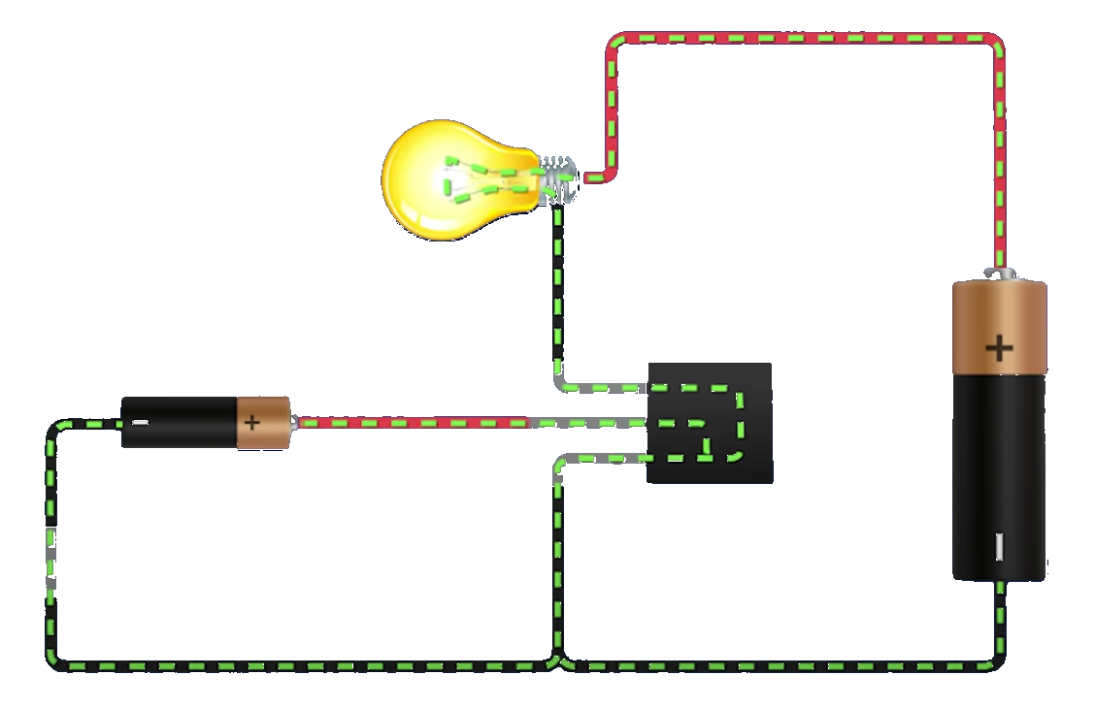
What can a transistor do?
Replacing the switch with a transistor allows us to remotely control the circuit.
Remote switch
Notes:
Remote circuit can operate on a completely different voltage than the main circuit.

Slide 21
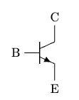
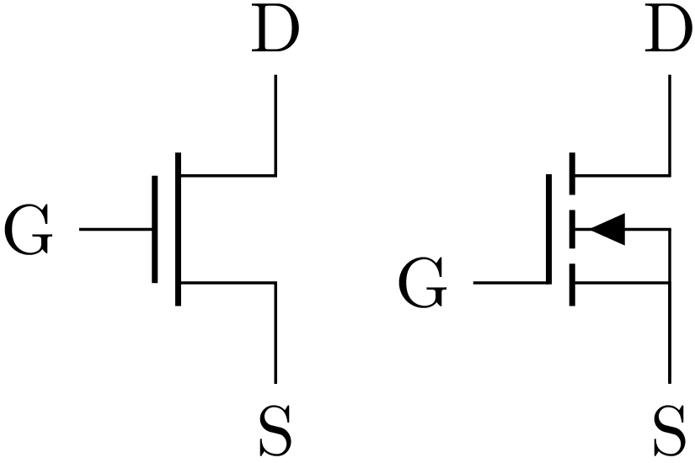
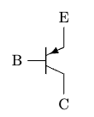
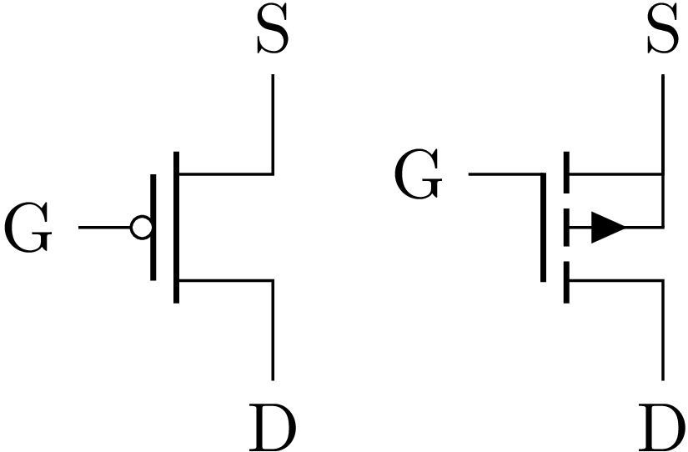
Two Types of Transistors
Bipolar junction transistor (BJT or bipolar)
NPN (N-type)
PNP (P-type)
Metal oxide field effect transistor (MOSFET or FET)
N-Channel (NFET or NMOS)
P-channel (PFET or PMOS)
Notes:
These are some of the symbols you'll see.

Slide 22
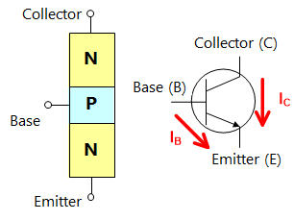
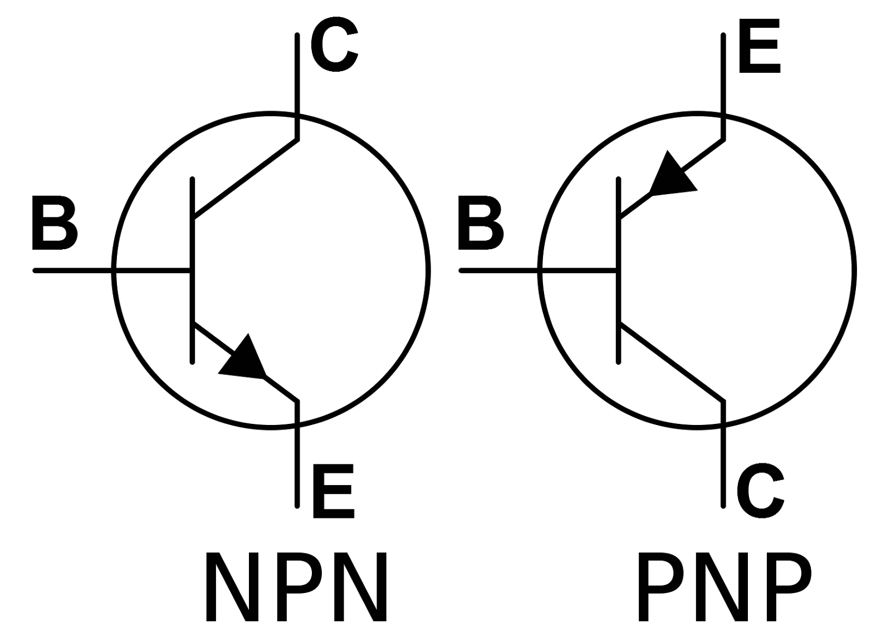
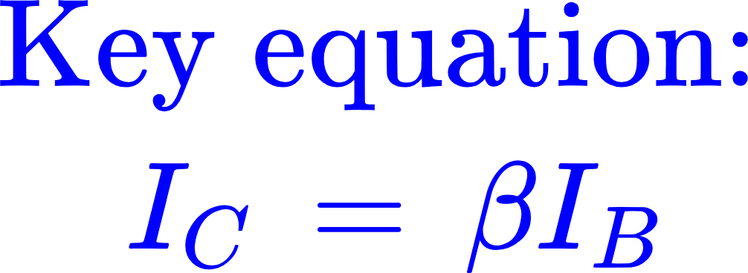
Bipolar Junction Transistors
NPN transistor
Collector current
V_{BE}> 0.7V
turns transistor switch 'on'
I_{C}
I_{B}
I_{E}
Base current
This is a diode!
If V_{BE} large enough (> 0.7V generally), base current I_{B} will start to flow.
A BJT is a current-controlled device. The base current controls the collector current.
Notes:
A BJT transistor consists of three differently doped semiconductors. The main atom is typically silicon, which has 4 electrons in the outer shell. The dopant atoms are close in size to the silicon atom, so they don’t cause any undue strain on the lattice.
The N-Type dopants such as Phosphorus provide an extra electron which does not participate in any of the covalent bonds, and it therefore can move about easily.
The P-Type dopants such as Boron have only three electrons in their outer shell which creates "holes" in the covalent bonds. These holes can also move around by virtue of electrons jumping from one hole to another hole (the hole moves in the opposite direction of the electron).
The NPN transistor comes with two junctions, called:
Emitter-Base Junction.
Collector-Base Junction.
The NPN transistor is in operating condition when an emitter-base junction is forward biased and the collector-base junction is reverse biased and enough current is present at the base terminal. In order to make emitter-base junction forward biased, a positive voltage is applied at the base side and a negative voltage is applied at the emitter side.
Beta tends to be ~50 or so. Main thing is that it is positive.

Slide 23

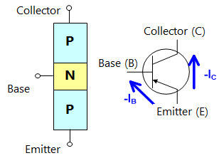
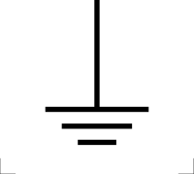
Bipolar Junction Transistors
Where does the load go?
+V_{CC}
NPN transistor
PNP transistor
+V_{CC}
Emitter
I_{C}
I_{E}
I_{B}
I_{B}
I_{E}
I_{C}
Collector
Low side switch
High side switch
Notes:
Point out that current (like a diode) flows in the direction of the arrow in the symbol.
Current flows from + to -, so it makes sense that the PNP will be “on top”.
1. Emitter:
• The emitter “emits” or supplies charge carriers (electrons in an NPN transistor or holes in a PNP transistor) into the base region.
• It is heavily doped to ensure a high concentration of charge carriers, maximizing their injection into the base.
2. Base:
• The base is the thin, central region of the transistor that “bases” or supports the operation by controlling the flow of charge carriers between the emitter and collector.
• It is lightly doped and very thin to allow most of the charge carriers emitted by the emitter to pass through to the collector.
3. Collector:
• The collector “collects” the charge carriers that flow through the base from the emitter.
• It is moderately doped and has a larger physical area to dissipate the heat generated by power dissipation in the device.

Slide 24
Examine BJT Datasheets. Fill in the table.
Part Number | Type (PNP or NPN) | 𝛽 (or h_{FE}) | Max collector current
KSC2073
TIP42
2N3906
2N3904

Slide 25
Why are there three values sometimes? (Min, Typ, Max)
Manufacturing Variation: No two BJTs or MOSFETs are identical. Parameters like 𝛽 (h_{FE}) vary significantly across a single production batch.
The 3-Sigma Rule: Manufacturers often specify Min and Max values to represent the 3σ (three standard deviations) points of a normal distribution.
Typical (Typ): The average or "mean" value you are most likely to see.
Min/Max: Only about 0.15% of parts will fall outside these boundaries on either end.
The Reality Check: If you pick a part off the shelf, it is highly likely to have a value near the "Typical," but it is guaranteed (mostly) to be at least the "Min" and no more than the "Max."
So what value should I pick??

Slide 26
The "Correct" Value Depends on the Question
There is no single "right" number to use; it depends on what you are trying to do.
Scenario A: "Will my circuit function?"
Goal: You need to ensure the transistor turns on even if it is the "weakest" one in the box.
Selection: Use Worst-Case Minimums (e.g., 𝛽_{min}).
Example: If you design for 𝛽_{max}, your circuit will fail for 99.85% of parts. Designing for 𝛽_{min} ensures nearly 100% yield.
Scenario B: "Will my circuit break or overheat?"
Goal: You need to ensure you don't exceed power limits.
Selection: Use Worst-Case Maximums (e.g., Max V_{OH}, Max Capacitance, Max Frequency).
Question: "Am I inside my power envelope?" You must assume the highest possible voltage and frequency to ensure the system survives the worst-case stress.
Summary: Always ask: "Does a higher or lower value make it harder for my design to succeed?" Use that value.
Added Complexity: Operating Conditions:
Remember that these values aren't static. They shift with temperature and other conditions.
Always check the datasheet graphs to see how your "Min" or "Max" values might further change when the circuit gets hot or cold.

Slide 27
Designing for Success: The "Worst-Case" Approach
The Trap of the Maximum:
Example: Using 𝛽_{max} to calculate base current.
If you design your circuit to only work if the gain is at its maximum value, your design will fail for 99.85% of the parts you buy, because almost all of them will have a gain lower than that.
The Golden Rule: Design for the Minimum (𝛽_{min}):
If your circuit functions correctly with the lowest possible gain specified, it will work for 99.85% of all parts in that product line.
Robustness: A good design "over-drives" the base slightly so that even the "weakest" transistor in the box still turns on fully.
Added Complexity: Operating Conditions:
Remember that these values aren't static. They shift with Temperature and Collector Current I_{C}.
Always check the datasheet graphs to see how your "Min" value might drop even further when the circuit gets hot or cold.

Slide 28
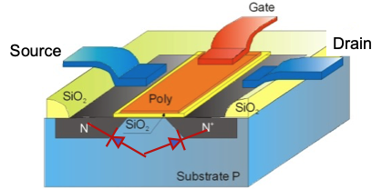
MOSFETS
MOSFET = Metal Oxide Semiconductor Field Effect Transistors
The BJT was the technology used to make integrated circuits, from the first ones in the early 1960s all the way until the late 1970s, when MOSFETs took over.
MOSFETs have two components:
The “field effect” is an electric field that creates a channel between two n-type regions for electrons to pass through.
This field is generated by an electrically-charged metal layer that is shielded from the semiconductor material by an insulating oxidized layer (thus the MOS component).
Terminals are called Gate, Drain and Source.

Slide 29
Two types: nFET and pFET
Depending on how the channel is formed:
N for nFETs, also called N-channel MOSFETs
P for pFETs, also called P-channel MOSFETs.
(There are two subtypes for each: enhancement and depletion type - we'll only use enhancement type here:
Enhancement type: MOSFET "turns on" when appropriate gate voltage is applied.)
Notes:
This is a little tricky to dance around.
nFETs start with a p-type channel (with no voltage on the gate).
When positive voltage is applied the majority carriers (positive holes) are repelled from beneath the gate.
Eventually, with enough potential, the minority carriers (electrons in p-type si) are attracted to the gate from the source (which is N-Type).
As soon as there are enough to connect source to drain, the channel region is said to be inverted (appears like N-Type - lots of electrons, even though it was doped P-Type).
This is probably more than they are going to want to absorb…

Slide 30
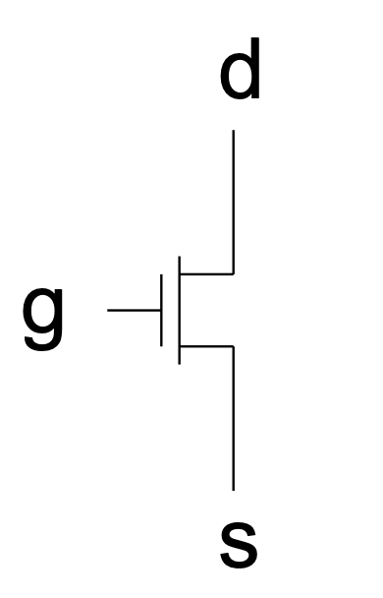
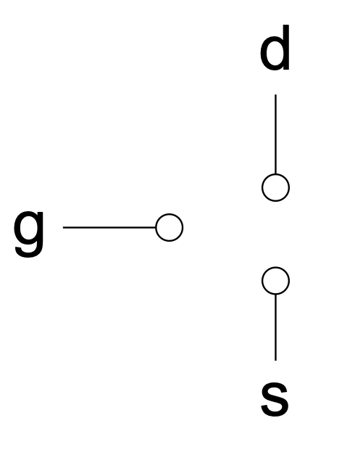
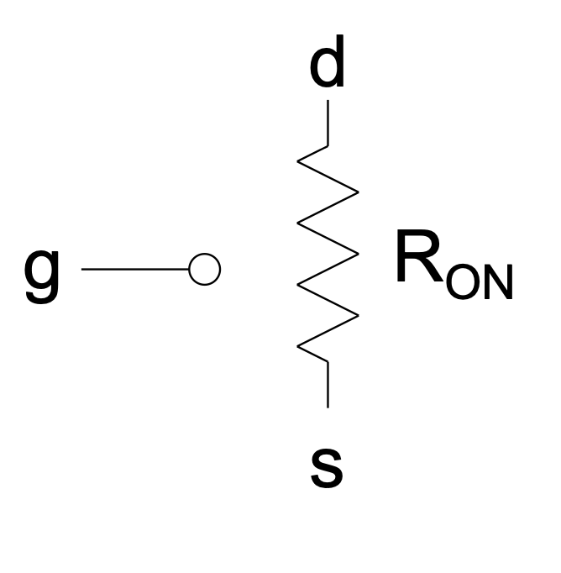
nMOSFET (nFET)
For our purposes, a MOSFET acts like a voltage-controlled resistor with two resistances: 0 and infinity.
The voltage between gate and source (V_{GS}) controls the resistance.
The threshold voltage V_{th} is the gate-source voltage at which the transistor is ‘on.’
V_{GS} >> V_{th}: ON
V_{GS} < V_{th}: OFF
A MOSFET is a voltage-controlled device. The gate voltage controls whether current flows between drain and source.
(R_{ON} is very small)
Gate voltage must be more positive than source voltage, hence V_{GS}>>...
Notes:
1. No Gate Current (Ideal Behavior):
Unlike a BJT, which is a current-controlled device, a MOSFET’s gate is insulated from the rest of the device by a thin oxide layer. This means that in ideal conditions, almost no current flows into the gate. The gate only controls the electric field.
2. Electric Field Effect:
The voltage applied to the gate terminal creates an electric field in the semiconductor channel below the gate (the channel between the source and drain). This field modulates the conductivity of the channel:
• If the gate voltage is below a certain threshold (V_{th}), the channel is not conductive, and little or no current flows between the drain and source.
• When the gate voltage exceeds the threshold, the electric field “inverts” the semiconductor region below the gate, creating a conductive channel through which current can flow between the drain and source.
3. Current Flow Proportional to Gate Voltage:
• In the linear region, the drain-source current (I_{DS}) is proportional to the gate-source voltage (V_{GS}), assuming the drain-source voltage is small.
• In the saturation region, the current becomes less dependent on the drain-source voltage and is instead controlled almost entirely by the gate-source voltage.
4. Advantages of Voltage Control:
• High Input Impedance: Since the gate draws almost no current, the MOSFET has a very high input impedance, making it efficient and easier to drive.
• Ease of Control: The ability to control large drain-source currents with relatively small gate-source voltages makes MOSFETs suitable for amplification and switching applications.
bulk is typically tied to lowest potential
While true, we haven’t mentioned the 4th terminal yet (in fact, they won’t see it until they study more advanced design techniques), so we could drop this.

Slide 31
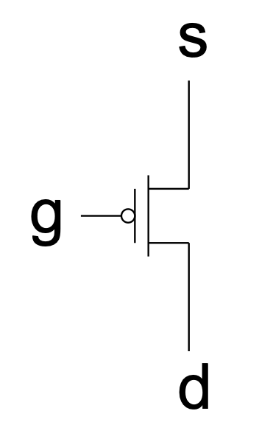
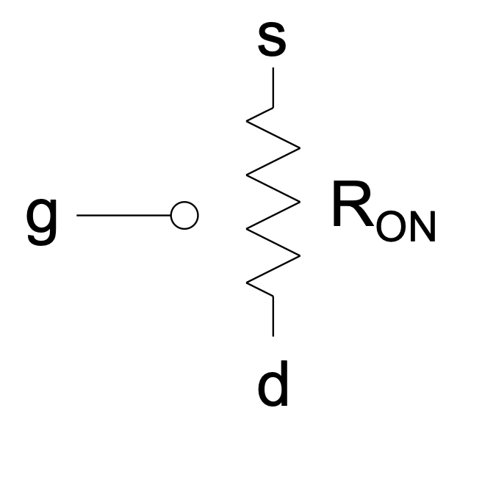
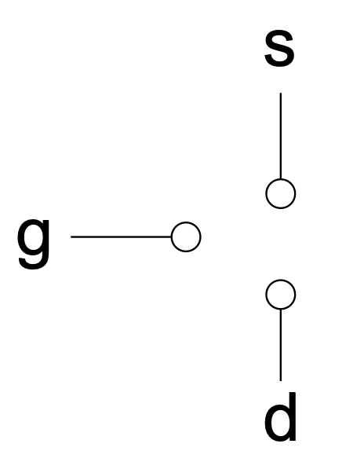
pMOSFET (pFET)
For our purposes, a MOSFET acts like a voltage-controlled resistor with two resistances: 0 and infinity.
The voltage between source and gate (V_{SG}) controls the resistance.
The threshold voltage V_{th} is the gate-source voltage at which the transistor is ‘on.’
V_{SG} >> V_{th}: ON
V_{SG} < V_{th}: OFF
(R_{ON} is very small)
Gate voltage must be more negative than source voltage, hence V_{SG}>>...
Notes:
pmos body is typically tied
to highest potential
(Could drop this too).

Slide 32
MOSFETs versus BJTs: first difference
MOSFETs:
Terminals are called
Gate
Drain
Source
MOSFETs only require a voltage at the gate pin to allow current flow between the drain and source pins.
MOSFETs are really easy to "saturate" (fully open), so super reliable for very fast switching.
BJTs:
Terminals are called
Base
Collector
Emitter
BJTs require that a current be applied to the base pin in order for current to flow between the collector and emitter pins.
Notes:
MOSFETs are really easy to "saturate", which just means that they are fully open, and they are dead reliable for very fast switching between their saturation and cut-off regions (fully on and fully off regions). This makes them wonderful switches, especially for high power applications like motors, lamps, etc.

Slide 33
MOSFET versus BJT: some of the differences
 | MOSFET | BJT
Polarity | Current can flow in either direction between the source and drain (unipolar). | BJT is a bipolar device (it has a polarity).
Controlling quantity | Controlled by the voltage on the gate (in fact, the current into the gate is zero!) | Controlled by current into the base terminal
Power consumption | The power consumption by a MOSFET is lower than that of a BJT. | Higher than that of a MOSFET.
Applications | MOSFET is suitable for high power applications. It is used in power supplies, etc | BJT is preferred for the low current applications. It is widely used as amplifiers, oscillators, and electronic switches.
Other | MOSFETs are vulnerable to damage by electrostatic charges due to the thin oxide layer. | BJT can be faster than FETs (no capacitance to charge) at the expense of more power.

Slide 34
Examine FET Datasheets. Fill in the table.
Part Number | Type (NFET or PFET) | Threshold voltage | Max drain current
IRF9Z24
BS250P
IRFZ24
BS107P

Slide 35
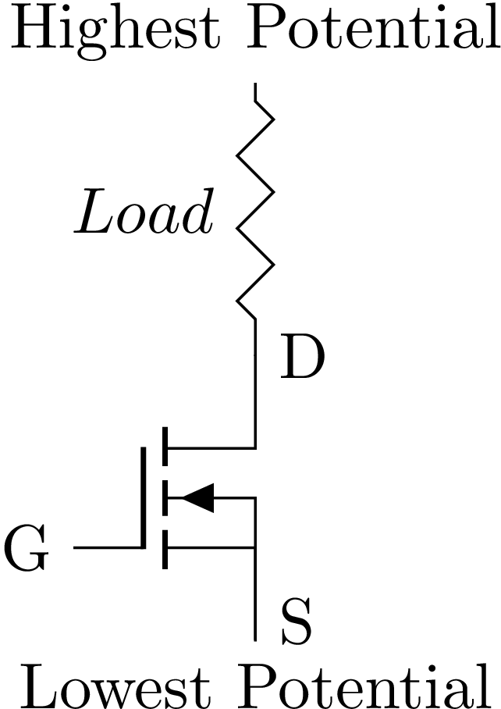
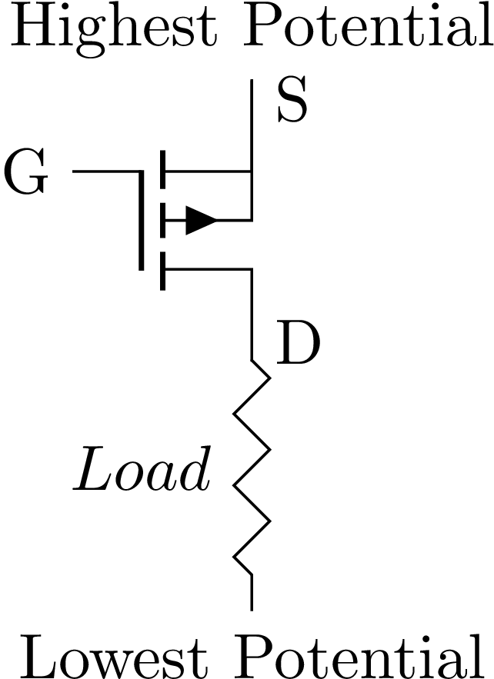
Correctly wiring a MOSFET
nFET:
Gate voltage more positive than source voltage
nFET 'on' when V_{GS}>>V_{th}
Drain voltage more positive than gate voltage (V_{DS}> V_{GS})
pFET:
Gate voltage more negative than source voltage
pFET 'on' when V_{SG}>>V_{th}
Drain voltage more negative than gate voltage (V_{SD}> V_{SG})
nFET: Pull Down
pFET: Pull Up
Low side switch
High side switch
Notes:
I think driving home that NFets are used to pull down and PFets are used to pull up is the key takeaway
here. That alone will make my job in 31 easier!
I think it is sufficient to acknowledge the existence of depletion mode devices (as you did on an earlier slide)
and never mention them again. They have a few traditional uses, but are a bit esoteric. (If you are interested,
they are basically fets that are ON with no applied gate voltage and you turn them more off with (negative)
gate voltage.) Depletion mode NFets tend to appear connected to the positive supply. Applying less than
Vcc to the gate makes the resistance go up. They are typically used as voltage controlled resistors)

Slide 36
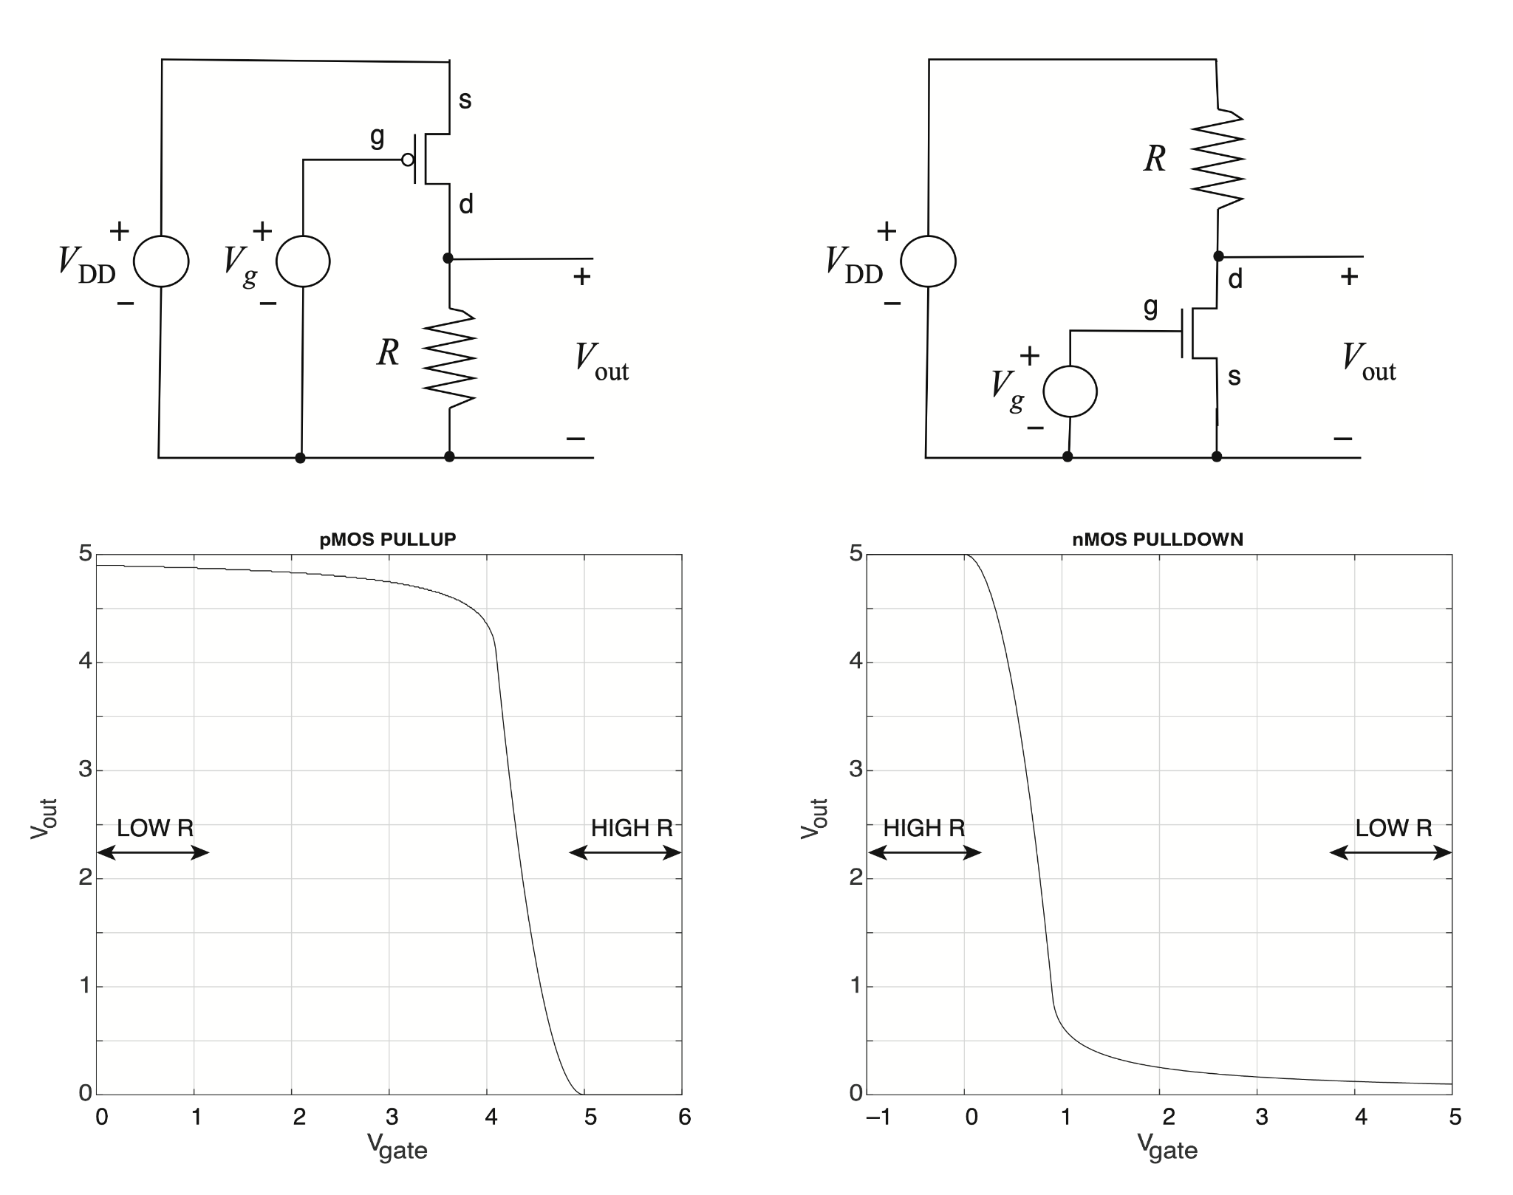
nFET: Pull Down
pFET: Pull Up
Notes:
I think driving home that NFets are used to pull down and PFets are used to pull up is the key takeaway
here. That alone will make my job in 31 easier!
I think it is sufficient to acknowledge the existence of depletion mode devices (as you did on an earlier slide)
and never mention them again. They have a few traditional uses, but are a bit esoteric. (If you are interested,
they are basically fets that are ON with no applied gate voltage and you turn them more off with (negative)
gate voltage.) Depletion mode NFets tend to appear connected to the positive supply. Applying less than
Vcc to the gate makes the resistance go up. They are typically used as voltage controlled resistors)

Slide 37
Continue Working on your Lab!

Slide 38
How do Transistors Work?
Super Brief Introduction to Semiconductor Devices

Slide 39
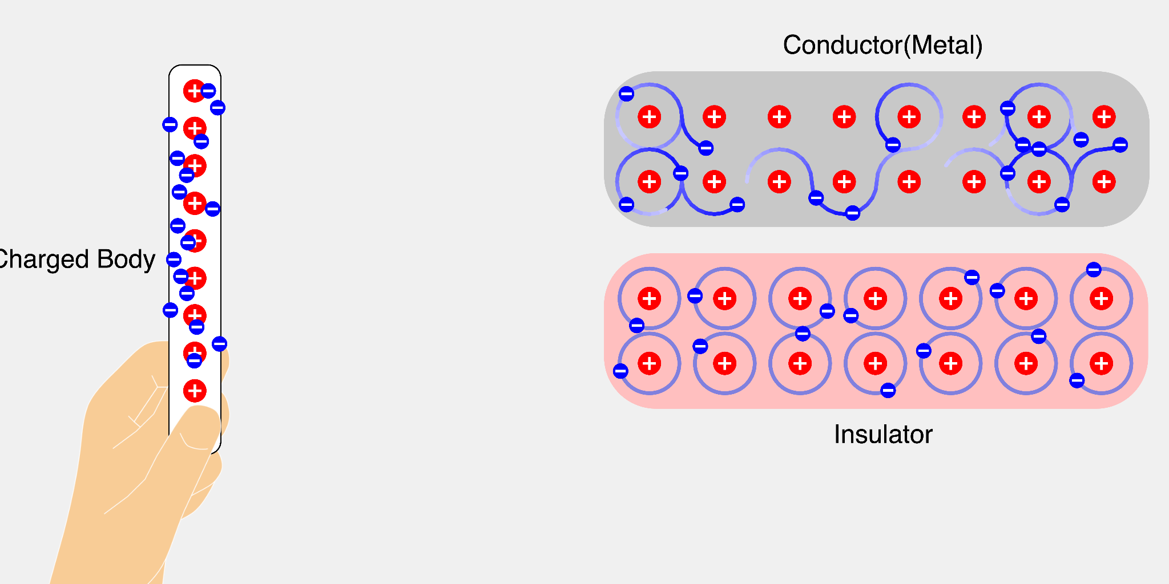
Conductor versus Insulator
3 or less electrons on valence shell, they easily break free and move around.
A “sea” of electrons can wander about crystal.
Since they are “free”, they respond to applied fields and give rise to conduction.
Example: copper
5 or more electrons on valence shell, takes huge energy to break free so they stay put.
There are no “free” electrons available so an electric field does not change anything with respect to electron distribution.
Electricity is not conducted.
Example: rubber

Slide 40
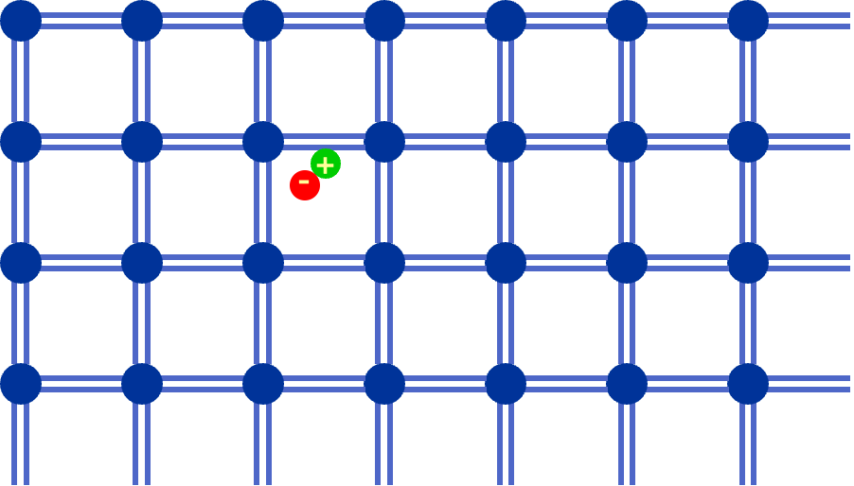
Meet Silicon (a Semiconductor)
Four valence electrons.
The electrical conductivity of a semiconductor falls in-between that of a conductor (such as copper) and that of an insulator (such as rubber).
A few bonds are broken and give rise to a few free electrons, along with leaving behind a positive hole.
Notes:
Intrinsic silicon has all 4 valence electrons covalently bonded to nearby atoms.
Thermal energy causes a statistically predictable number of electrons to escape their associated bond.
It is this thermal activity that allows silicon and semiconductors in general to conduct electricity.
As the temperature increases, more bonds are broken and the semiconductor becomes a better conductor.

Slide 41
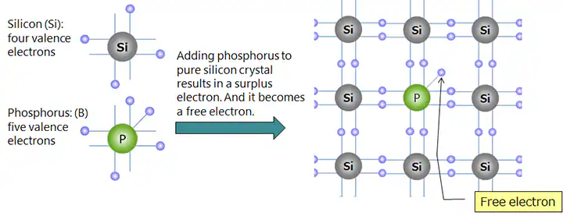
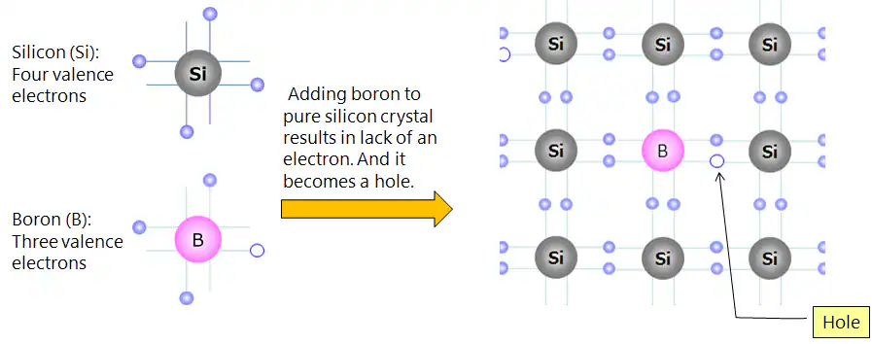
Doping: Replace some Si Atoms with…
n-type semiconductor
p-type semiconductor
Notes:
The dopant atoms are close in size to the silicon atom, so they don’t cause any undue strain on the lattice.
The N-Type dopants Phosphorus in this case provide an extra electron which does not participate in any of the covalent bond, and it therefore can move about easily.
People tend to have trouble conceptualizing a “hole”.
It is easiest to think it as a positive charge, which is, linguistically at least, the same as the absence of a negative charge…
It isn’t strictly a positive charge, but it behaves exactly as if it was.

Slide 42
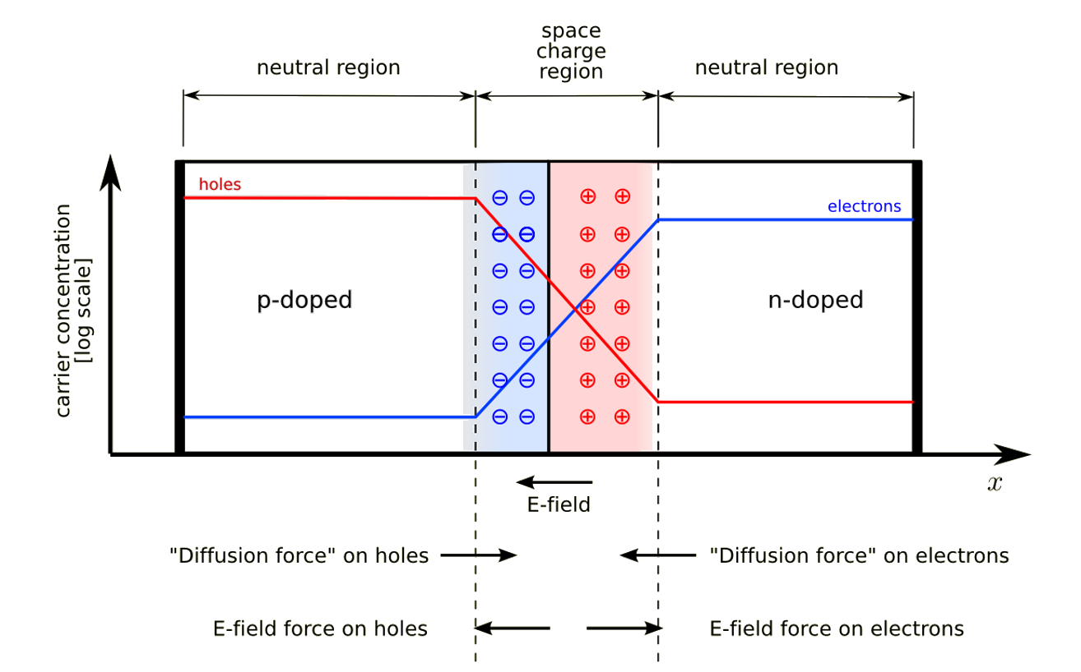
PN Junction: Stick p-type next to n-type.
neutral region
depletion region
neutral region
holes
electrons
n-type
p-type
Electric field
Some of the free electrons of the n-type region diffuse into the holes of the p-type region, creating holes in the n-type region. This creates a small electric field in the depletion region. At rest: equilibrium between diffusion and electric field.
Notes:
This can also be hard to conceptualize at first. It helps to imagine two pieces of silicon widely separated.
One is P type and one is N type.
Each is charge neutral and each has lots of carriers that are very loosely bound to their host atom.
When the two pieces are brought together, the higher density electrons (for example) in the N-Type notice a lower density in the P-Type and diffuse across in an attempt to reach equilibrium
The same applies to the holes.
Each electron that wanders into P territory disappears (is annihilated) when it encounters a mobile hole. (same in the other direction).
Also - each electron that leaves N-Type leaves behind an exposed (fixed) positive charge. (same in the other direction)
The process continues building a stronger and stronger electric field at the junction until the field is strong enough to overcome diffusion and we are at equilibrium.

Slide 43
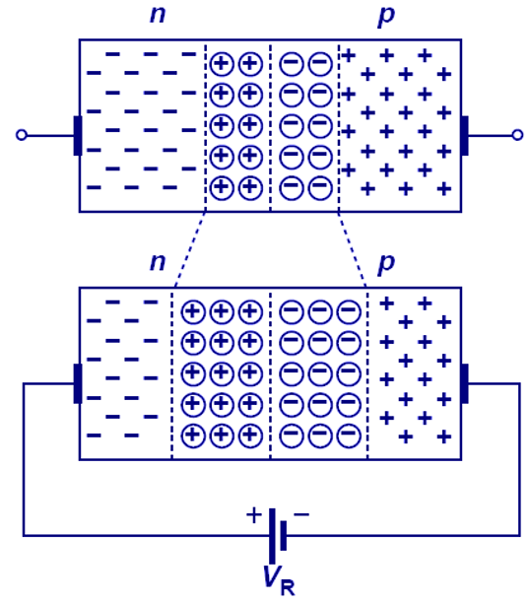
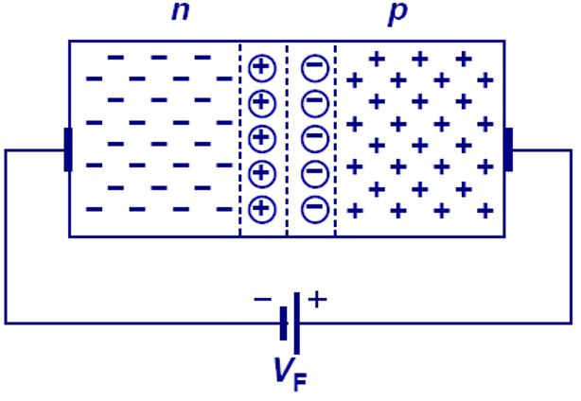
PN Junction - Biased
Forward bias:
'-' connected to n-region
'+' connected to p-region
Depletion region shrinks. Current can flow freely as soon as voltage > built-up potential.
Reverse bias:
'+' connected to n-region
'-' connected to p-region
Depletion region grows. No current can flow.
This is a diode!
Notes:
If the positive terminal of the battery is connected to the P-region and the negative terminal to the N-region, the PN Junction will be said to be operating in a Forward-Biased State.
The external voltage should be greater than the built-in potential i.e. 0.7V for Si, so that it could melt the depletion region.
In the Forward-Biased State, the Holes start to move towards the N-region and the electrons start flowing towards the P-region.
As a result, the width of the depletion region starts reducing and finally depletes out.
The current starts flowing through the semiconductor, as soon as the depletion region gets removed. We can say the semiconductor is acting as a conductor.
In this state, the semiconductor has maximum conductivity and quite low resistance.
If the P-region is connected with the negative terminal of the external source and the N-region with the positive terminal, the PN-Junction will operate in the reverse-biased state.
As the P-region is connected to the negative voltage, the holes in the P-region will get attracted towards the external voltage, so start flowing away from the depletion region. The same will be the case with the electrons.
So, no current will flow through the PN Junction in a reverse-biased state.
—- Tad’s Version below —-
Now that we understand the depletion region, let’s apply an external field (using a voltage source).
In the top diagram, we are applying a field from right to left (opposite of the intrinsic field)
The fields are additive, so the net field at the junction shrinks as we increase the voltage.
When we reach the built-in potential, the net field goes to zero and carriers are free to move
Around as they please. A tiny bit more potential will create a net field across the whole structure and current will flow
The bottom diagram shows what happens when the applied field is in the same direction as the built-in field.
The effect is to widen the depletion region, making it harder for current to flow (so none does).

Slide 44
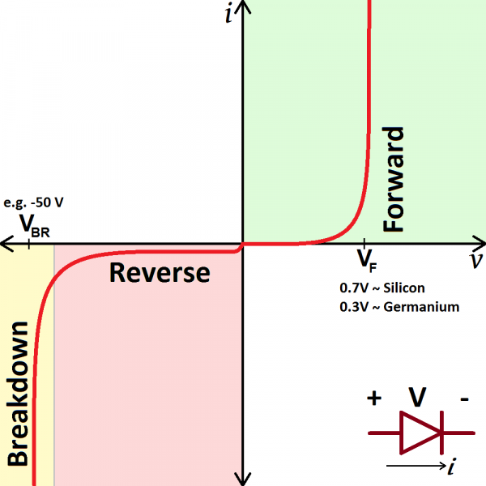
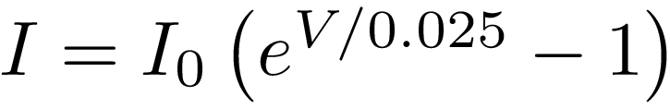
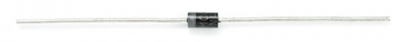
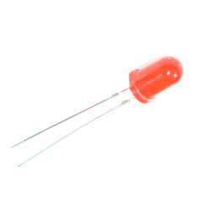
PN Junction - Diode
Notes:
Current is exponential (until breakdown when other effects take over).
0.025V is kT/q (Boltzmann * T in Kelvin)/(charge of electron)
I0 is very small, but exponents get big quickly.
In reverse, there is always some current flowing (V negative allows very small “leakage” current)

Slide 45
Bipolar Junction Transistors: P sandwiched between two N regions or N sandwiched between two P regions
NPN transistor
PNP transistor
Emitter
Terminals are called Base, Collector and Emitter.
Base region is lightly doped and very thin
Emitter is heavily doped
Collector is heavily doped except close to the base where it is only lightly doped
Collector

Slide 46
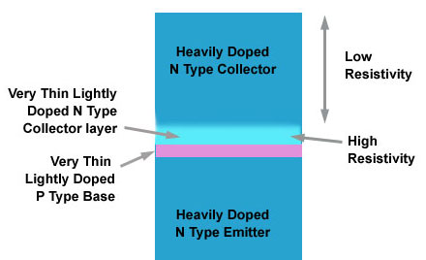
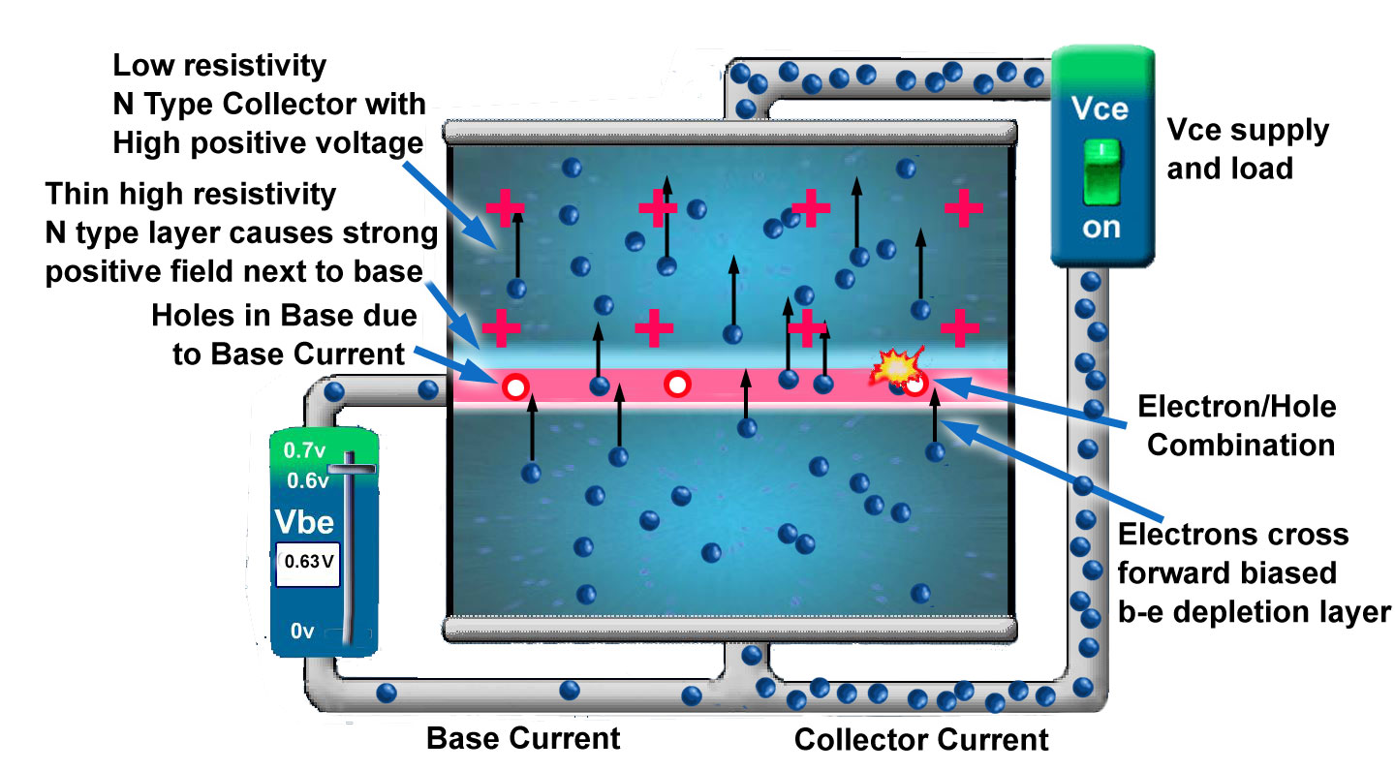
NPN Transistor
Notes:
During normal operation, a potential is applied across the base/emitter junction so that the base is approximately 0.6v more positive than the emitter, this makes the base/emitter junction forward biased.
A much higher potential is applied across the base/collector junction with a relatively high positive voltage applied to the collector, so that the base/collector junction is heavily reverse biased. This makes the depletion layer between base and collector quite wide once power is applied.
As mentioned above, the collector is made up of mainly heavily doped, low resistivity material with a thin layer of lightly doped, high resistivity material next to the base/collector junction. This means that most of the voltage between collector and base is developed across this thin high resistivity layer, creating a high voltage gradient near the collector base junction.
When the base emitter junction is forward biased, a small current will flow into the base (with engineering convention… electrons really flow out of the base into the power source…). Therefore holes are injected into the P type material (well, electrons are removed by the power source). These holes attract electrons across the forward biased base/emitter junction to combine with the holes. However, because the emitter region is very heavily doped, many more electrons cross into the P type base region than are able to combine with the available holes. This means there is a large concentration of electrons in the base region and most of these electrons are swept straight through the very thin base, and into the base/collector depletion layer. Once here, they come under the influence of the strong electric field across the base/collector junction. This field is so strong due to the large potential gradient in the collector material mentioned earlier, that the electrons are swept across the depletion layer and into the collector material, and so towards the collector terminal.
Varying the current flowing into the base, affects the number of electrons attracted from the emitter. In this way very small changes in base current cause very large changes in the current flowing from emitter to collector, so current amplification is taking place.

